Slide 1
Redux Toolkit

Slide 2
Introduction to Redux Toolkit
Redux Toolkit Architecture
Installing Redux Toolkit
Creating the Redux Store
Provider
What is a Slice?
Creating a Slice
8. Initial State
9. Reducers in Redux Toolkit
11. Actions
12. Payload
13. useDispatch()
14. useSelector()
15. Context API vs Redux Toolkit

Slide 3
1. Introduction to Redux Toolkit
Redux Toolkit (RTK) is the official recommended way to write Redux logic.
It simplifies Redux development and reduces boilerplate code.
Provides built-in utilities for creating stores, slices, reducers, and async logic.
Works seamlessly with React through react-redux.
Makes Redux code easier to write, maintain, and organize.

Slide 4
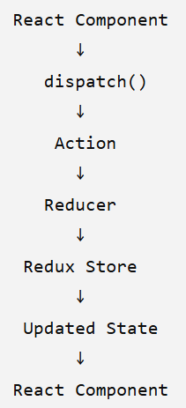
2. Redux Toolkit Architecture
Component dispatches an action.
Slice reducer processes the action.
Store updates the state.
Components using that state are updated.

Slide 5
3. Installing Redux Toolkit
Installation Command :
npm install @reduxjs/toolkit react-redux
// @reduxjs/toolkit → Provides Redux Toolkit functionality.
// react-redux → Connects Redux with React components.

Slide 6
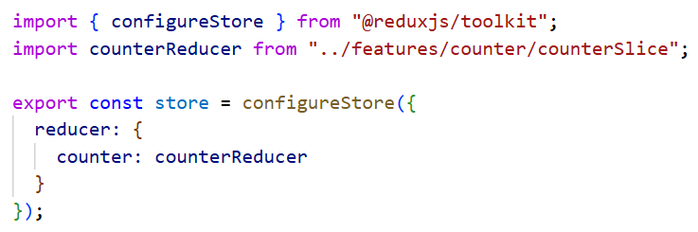
4. Creating the Redux Store
The store is the central location for application state.
configureStore() creates and configures the Redux store.
Multiple feature reducers can be registered in the store.

Slide 7
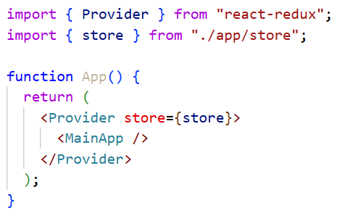
5. Provider
Provider makes the Redux store available to React components.
It is generally placed at the root of the application.
The store is passed using the store prop.

Slide 8
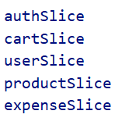
6. What is a Slice?
A slice represents one feature or section of the application state.
Created using createSlice().
A slice contains:
  Slice name
  Initial state
  Reducers
  Actions
Redux Toolkit automatically generates action creators from reducers.

Slide 9
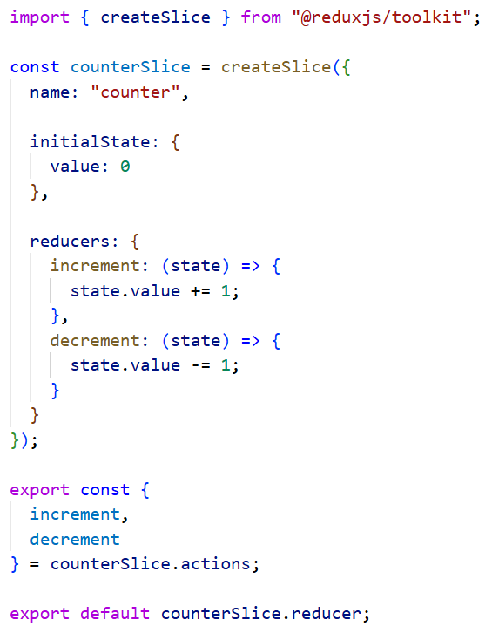
7. Creating a Slice
name → Name of the slice.
initialState → Starting state.
reducers → Functions that modify the state.
actions → Automatically generated from reducers.
reducer → Exported and added to the store.

Slide 10
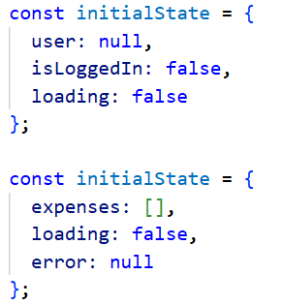
8. Initial State
initialState defines the initial data of a slice.
It can contain a single value or multiple properties.
The state structure should represent the feature being managed.

Slide 11
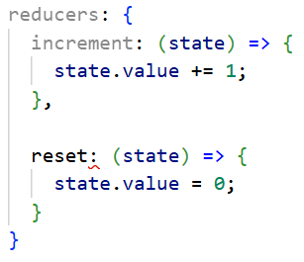
9. Reducers in Redux Toolkit
Reducers define how the state changes.
Each reducer handles a particular action.
Redux Toolkit uses Immer internally.
This allows developers to write mutation-style code while maintaining immutable state updates internally.

Slide 12
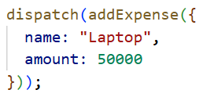
10. Actions
Actions describe an event that occurred.
Redux Toolkit automatically creates actions from the reducers defined inside createSlice().
Actions can also carry additional data through a payload.

Slide 13

11. Payload
Payload is the data sent along with an action.
Used when the reducer needs additional information.

Slide 14
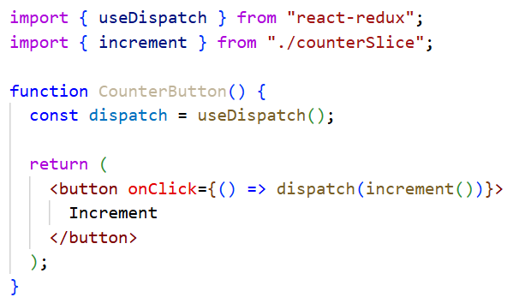
12. useDispatch()
useDispatch() gives access to the Redux dispatch function.
Used to send actions from React components.
Dispatching an action triggers the corresponding reducer.

Slide 15
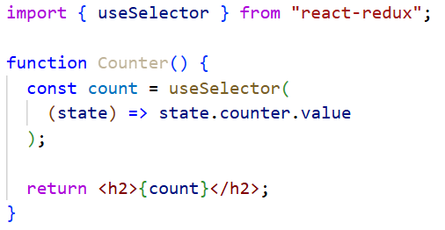
13. useSelector()
useSelector() is used to read data from the Redux store.
It selects a specific part of the Redux state.
The component re-renders when the selected state changes.

Slide 16
14. Context API vs Redux Toolkit
Context API | Redux Toolkit
Built into React | Separate Redux package
Simple shared state | Structured application state
Minimal setup | More features and structure
No built-in reducers/actions system | Slices provide reducers/actions
Suitable for simple global values | Suitable for complex shared state
Async logic requires additional patterns | Provides Redux Toolkit async utilities

